Slide 1
Undergraduation at pstu
Name: Mobin Haque
Faculty of computer science and engineering
ID: 2102064
Reg: 10191
Monday, April 24, 2023

Slide 2
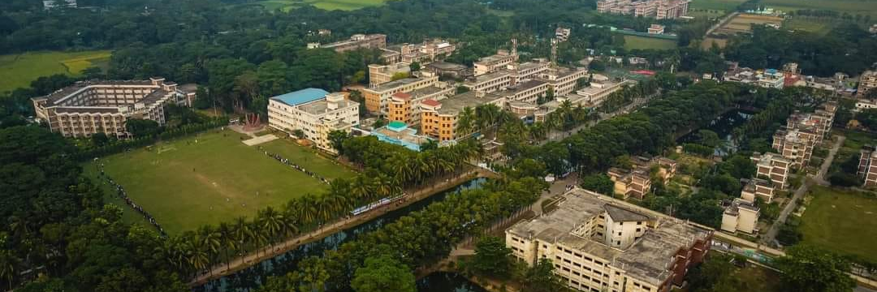
Patuakhali Science and Technology University (PSTU) is a public university located in Patuakhali, Bangladesh. It was established in 2000 and is currently one of the leading science and technology universities in Bangladesh. PSTU offers undergraduate and graduate programs in various fields of science, engineering, technology, and agriculture. The university has a modern campus with state-of-the-art facilities and laboratories, and its faculty members are highly qualified and experienced. The university's mission is to provide quality education and research opportunities to students, promote innovation and entrepreneurship, and contribute to the socio-economic development of the country.

Slide 3
rating all the homework assignments for this class based on fun and difficulty, on a scale of 1-10, where 1 is not fun and 10 is extremely fun, and 1 is very easy and 10 is very difficult.

Slide 4
List of departments of cse faculty
CSE Department
Department of Computer and Communication Engineering
Department of Computer Science and Information Technology
Department of Electrical and Electronics Engineering
Department of Mathematics
Department of Physics and Mechanical Engineering

Slide 5
My Education
Exam | Subject | Board | Year | Result
HSC | Science | Rajshahi | 2021 | G.P.A 5
SSC | Science | Rajshahi | 2019 | G.P.A 5
JSC | General | Rajshahi | 2017 | G.P.A 5
PEC | General | Rajshahi | 2013 | G.P.A 5

